Slide 1
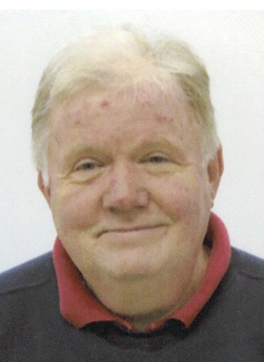
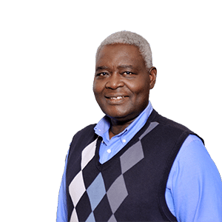
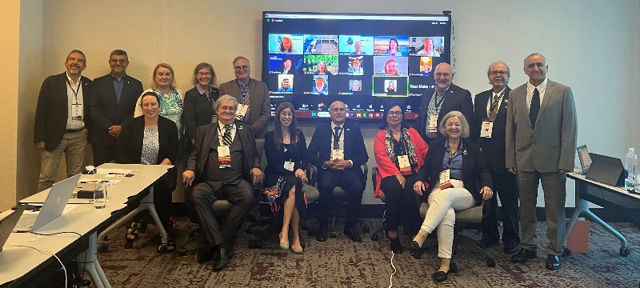
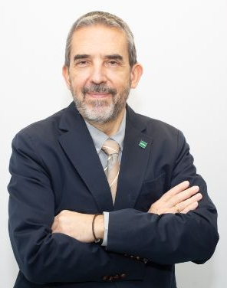
Thanks Rob from all your IEEE Education Society friends !

Slide 2
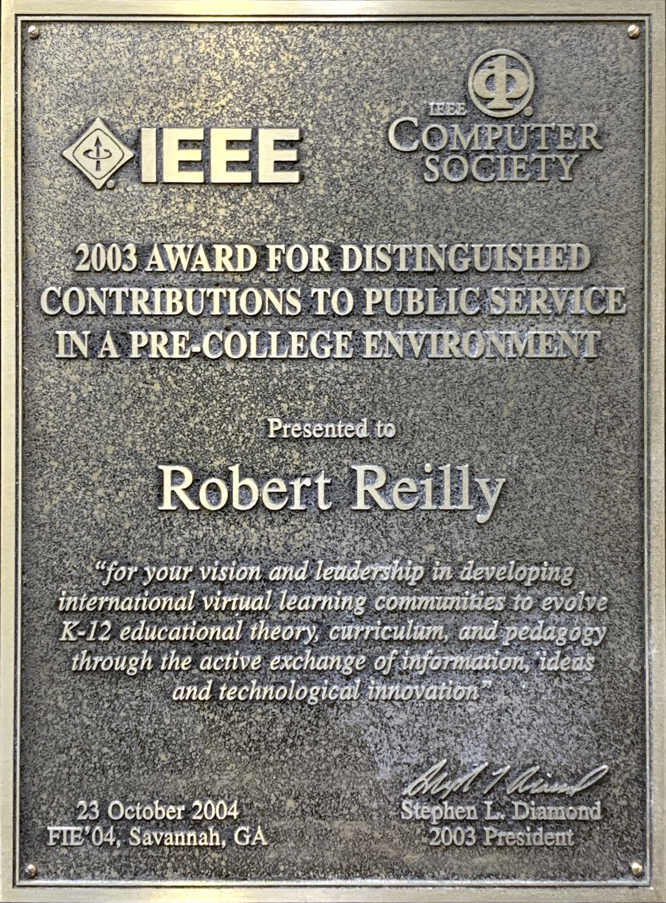

Slide 3
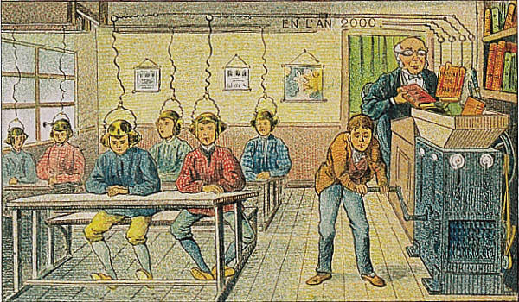

Slide 4
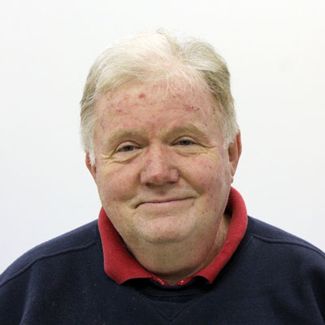
Rob Reilly
Doctor of Education (not engineering)
MIT Media Lab
Teacher 30+ years
2011-2012 President, IEEE Education Society
Director-elect, IEEE Board of Directors

Slide 5
Have Goals, Have Reachable Goals, Have Unreachable Dreams: Win the Nobel Prize
Rob Reilly Ed.D.

Slide 6
Curiosity is the leading cause of Knowledge

Slide 7
Intelligence, Curiosity…
I’m not that much smarter than anyone else, I just stay with a problem longer.
--Albert Einstein

Slide 8
Delivering Knowledge and Fast Food in the 21st Century

Slide 9
“Acquire knowledge,
it enables its professor to distinguish right from wrong…
it is our friend in the desert, our company in solitude and companion when friendless…
it sustains us in misery,
it is an ornament amongst friends… armor against enemies”
Prophet Mohammed
(peace be upon him)

Slide 10
Reilly’s Rule
Teacher’s can no longer only throw information at students and expect ‘education’ to occur!

Slide 11
The illiterate of the 21st century will not be those who cannot read and write, but those who cannot learn, unlearn, and relearn.
—Alvin Toffler

Slide 12
“it is in fact nothing short of a miracle that the modern methods of instruction have not yet entirely strangled curiosity and inquiry”
—Albert Einstein

Slide 13
“Acquire knowledge…”
Over the past 10 years and over the previous century, we have seen mega change in, for example, transportation, medicine, and, communications!
What changes have there been in Education, in teaching pedagogy in the past 10 years, in previous centuries?

Slide 14
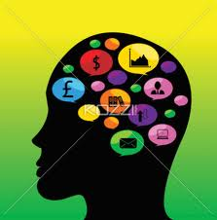
How high is UP for brain power
Studies: multi tasking is cognitive overload
brain pathways not developed
Need practice MULTI TASKING…
At young age
Using GENERIC skills
NOT primarily specific subject
Develop PATHS – build, mature

Slide 15
my BIG concern
How do we deliver the fruits of knowledge to a student.

Slide 16
The obstacles…
Students not equipped to meaningfully understand STEM (theory & function)
Brain areas not developed, not exercised,
build automobiles w/out building an automobile factory

Slide 17
The obstacles…
Evolve the Language of Education
Language of Function in this example is…
apply it to a model

Slide 18
What is the Language of Education

Slide 19
We must understand the function-of and relationship-of:
Intelligence
Knowledge
Wisdom
Information
Data
Education
Teaching/Learning
Pedagogy
Disambiguate terms

Slide 20
We must understand the function-of and relationship-of:
Intelligence → capability solve think

Slide 21
We must understand the function-of and relationship-of:
Intelligence → capability solve think
Knowledge → collection of beliefs, methods, ideas, models, facts, culturally neutral, assemble jigsaw

Slide 22
We must understand the function-of and relationship-of:
Intelligence → capability solve think
Knowledge → collection of beliefs, methods, ideas, models, facts, culturally neutral, assemble jigsaw
Wisdom → adds a value system to knowledge, cultural / organizational / personal gain /l oss

Slide 23
We must understand the function-of and relationship-of:
Intelligence → capability solve think
Knowledge → collection of beliefs, methods, ideas, models, facts, culturally neutral, assemble jigsaw
Wisdom → adds a value system to knowledge, cultural/organizational/personal gain/loss
Information → answer to a question

Slide 24
We must understand the function-of and relationship-of:
Intelligence → capability solve think
Knowledge → collection of beliefs, methods, ideas, models, facts, culturally neutral, assemble jigsaw
Wisdom → adds a value system to knowledge, cultural/organize/personal gain/loss
Information → answer to a question
Data → answer to Q nobody has asked

Slide 25
We must understand the function-of and relationship-of:
Intelligence → capability solve think
Knowledge → collection of beliefs, methods, ideas, models, facts, culturally neutral, assemble jigsaw
Wisdom → adds a value system to knowledge, cultural/organizational/personal gain/loss
Information → answer to a question
Data → answer to Q nobody has asked
Education → BIG process: provide tools for thought

Slide 26
We must understand the function-of and relationship-of:
Intelligence → capability solve think
Knowledge → collection of beliefs, methods, ideas, models, facts, culturally neutral, assemble jigsaw
Wisdom → adds a value system to knowledge, cultural/organizational/personal gain/loss
Information → answer to a question
Data → answer to Q nobody has asked
Education → BIG process: provide tools for thought
Teaching/Learning → mutual exclusive, can’t teach, provide opportunities to learn (Socrates)

Slide 27
We must understand the function-of and relationship-of:
Intelligence → capability solve think
Knowledge → collection of beliefs, methods, ideas, models, facts, culturally neutral, assemble jigsaw
Wisdom → adds a value system to knowledge, cultural/organizational/personal gain/loss
Information → answer to a question
Data → answer to Q nobody has asked
Education → BIG process: provide tools for thought
Teaching/Learning → mutual exclusive, can’t teach, provide opportunities to learn (Socrates)
Pedagogy → METHOD: seminar, lecture, project

Slide 28
We must understand the function-of and relationship-of:
Intelligence → capability solve think
Knowledge → collection of beliefs, methods, ideas, models, facts, culturally neutral assemble jigsaw
Wisdom → adds a value to knowledge, cultural/organize/personal gain/loss
Information → answer to a question
Data → answer to Q nobody has asked
Education → BIG process: provide tools for thought
Teaching/Learning → mutual exclusive, can’t teach, provide opportunities to learn (Socrates)
Pedagogy → METHOD: seminar, lecture, project

Slide 30
Reilly’s Rule
Teacher’s can no longer only throw information at students and expect ‘education’ to occur!

Slide 31
How do you recognize a student that is:
bored
frustrated
doing cognitive assessment
What do you do about it?

Slide 32
Emotion Axes
-1 -0.5 0 +0.5 +1
anxiety worry discomfort comfort hopeful confident
ennui boredom indifference interest curiosity fascination
frustration confusion puzzlement insightful enlightened euphoric
dispirited disillusioned dissatisfied wistful hopeful encouraged
terror dread apprehension calm enchanted enthralled awe
humiliation embarrassed chagrin content pleased prideful

Slide 33
Curiosity is the leading cause of Knowledge

Slide 34
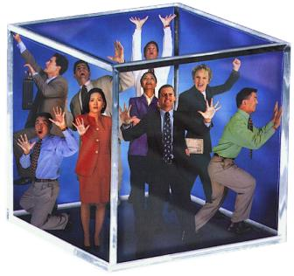
Thinking Outside the Box
What is life like inside the Box?

Slide 35
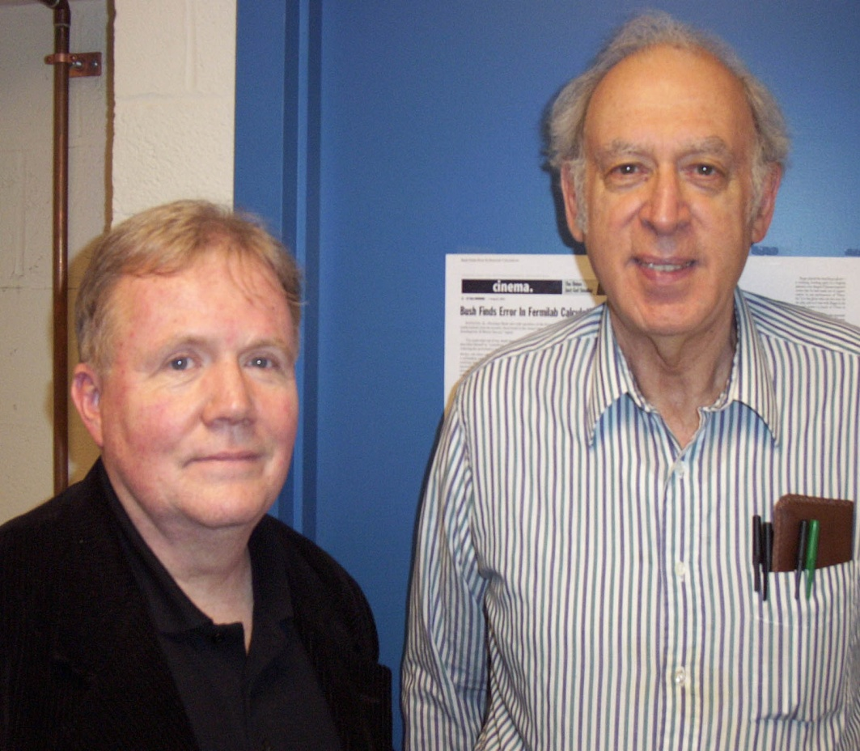
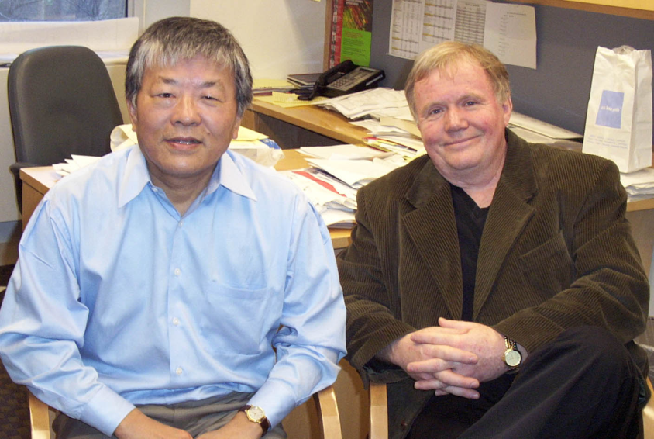
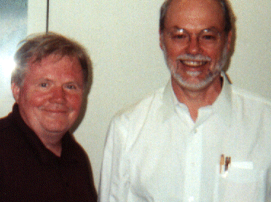
Thinking Outside the Box
As close as I will come to a Nobel Prize?

Slide 36
Pablo Picasso was not just another artist: Why was that?
Rob Reilly Ed.D.

Slide 37
In Conclusion
Delivering knowledge not technology
Reilly’s Rule: Teacher’s can no longer just throw information at students and expect ‘education’ to occur!
Change in PEDAGOGY – methods
Recognize affective state (emotions)
Managing the BRAIN functionS
Digital Outsourcing was Call Center process
rule-based vs. model-based activities

Slide 38
In Conclusion
Goal: Deliver functional adult
How do we construct one?
Develop brain pathways in primary school
Develop/understand Language of Education
Rule-based vs. Model-based knowledge domains
Manage affective state of learner (emotions)
What are your strengths?

Slide 39
The Science Behind the Art of Teaching a Science
Dr. Rob Reilly
reilly@media.mit.edu

Slide 40
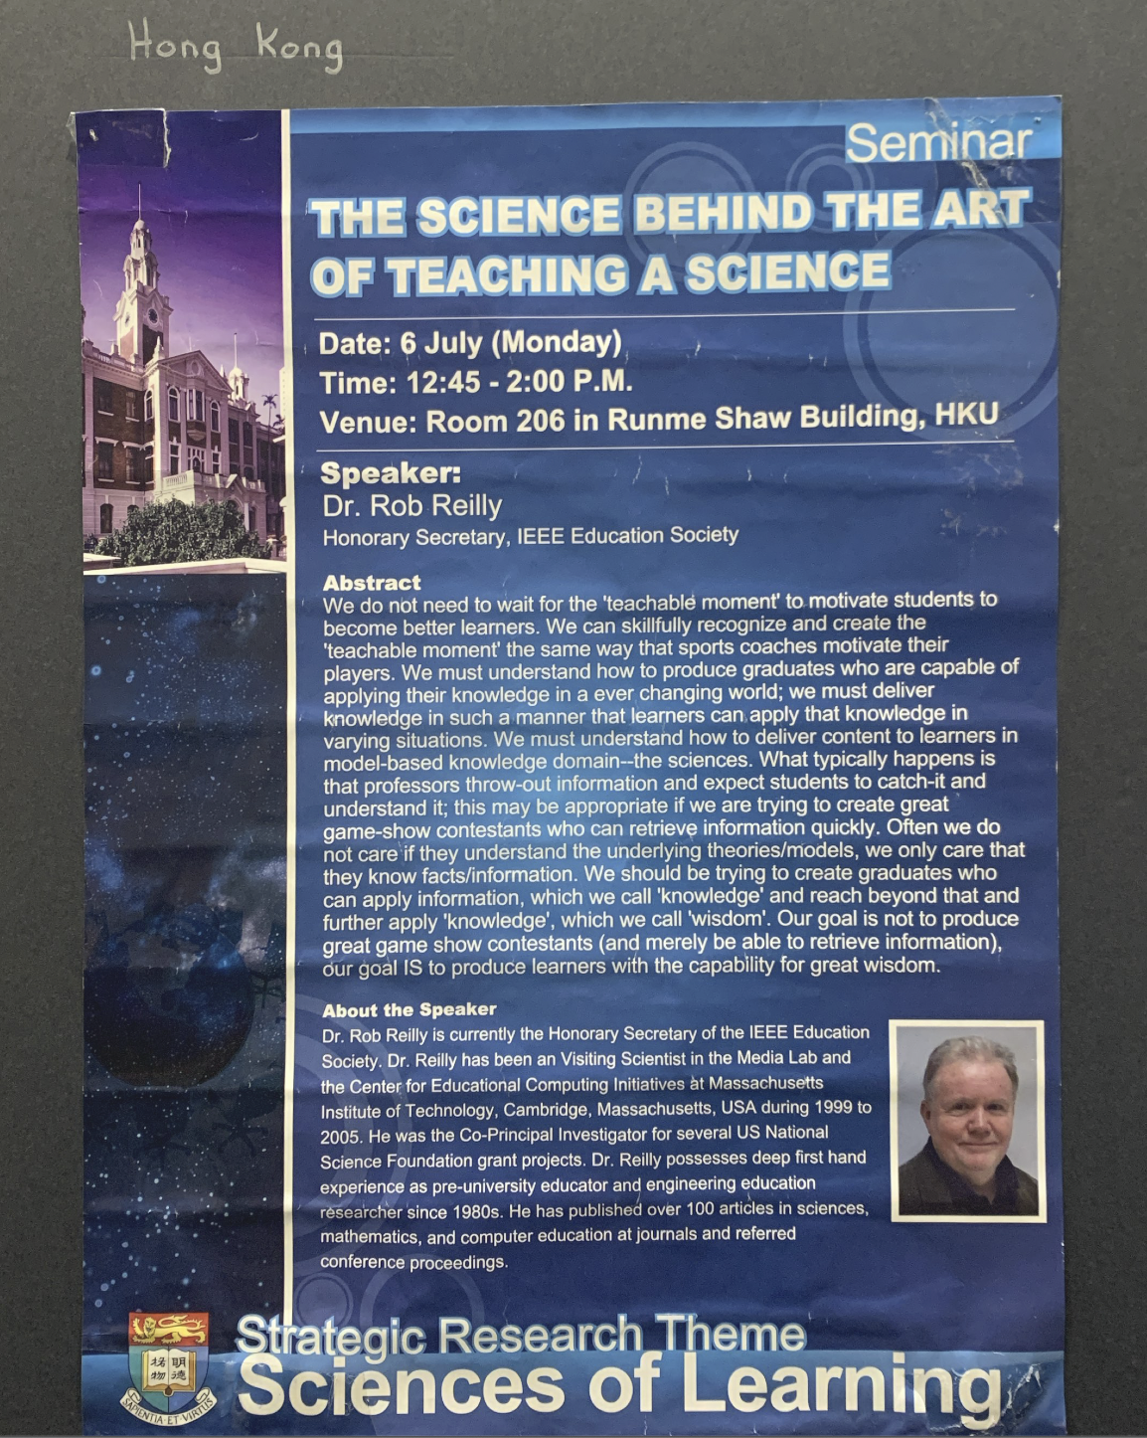

Slide 42
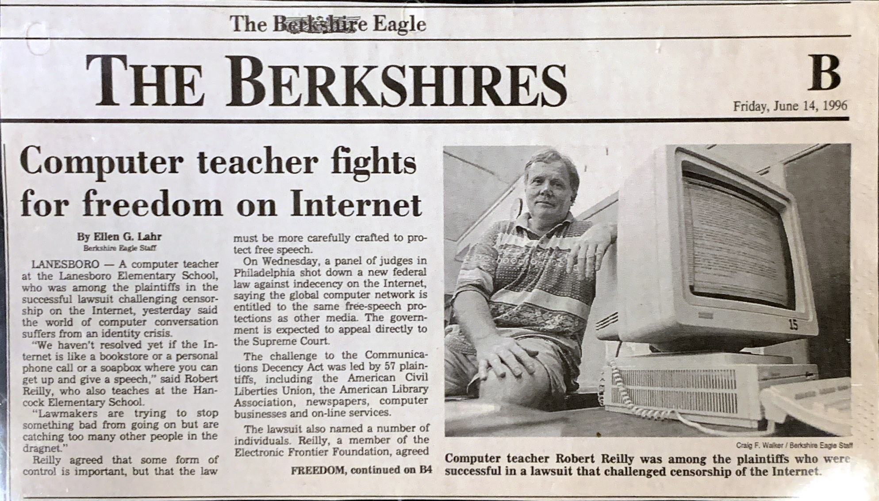

Slide 43
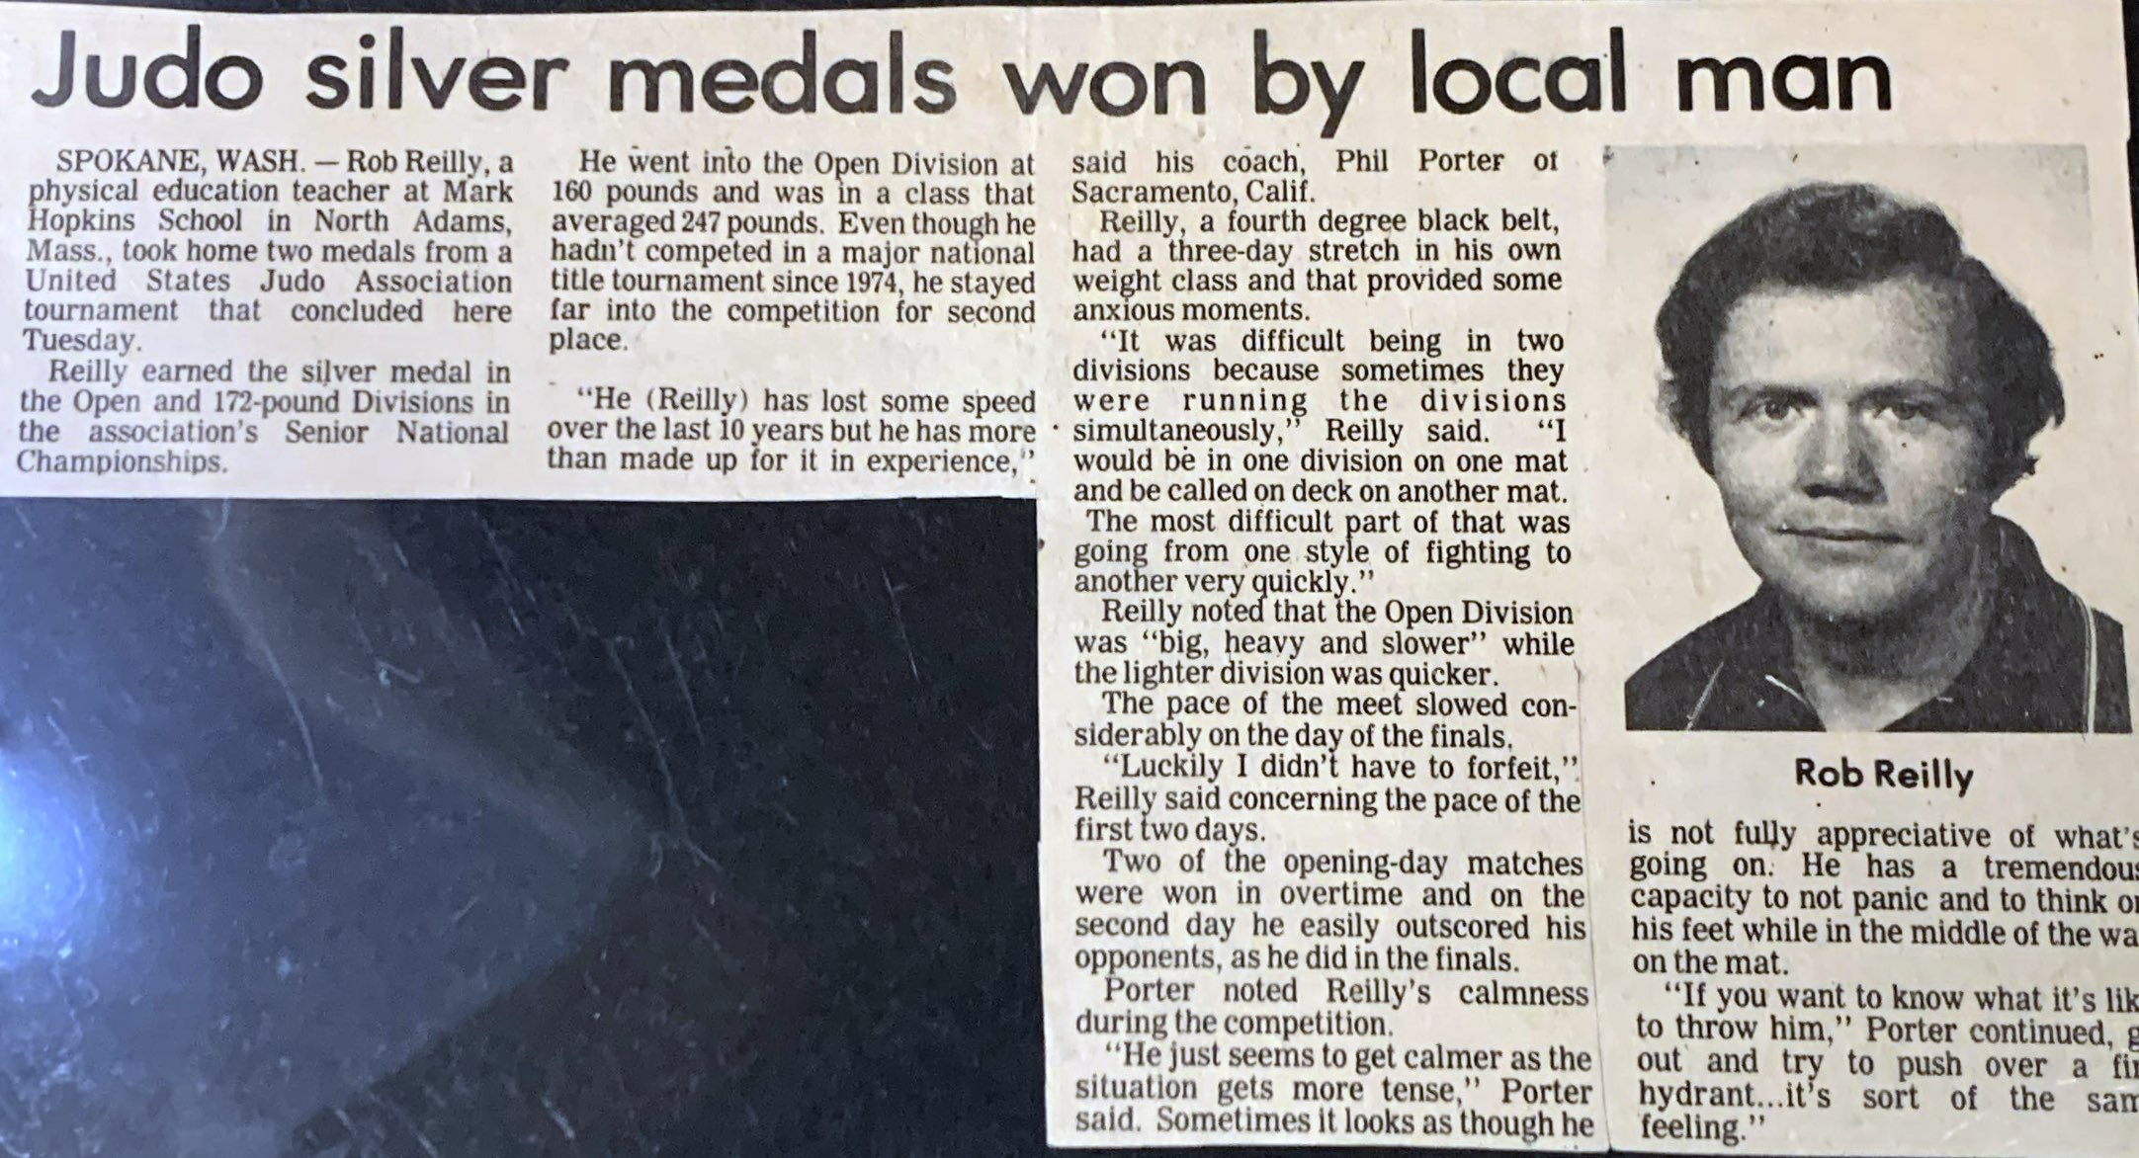

Slide 44
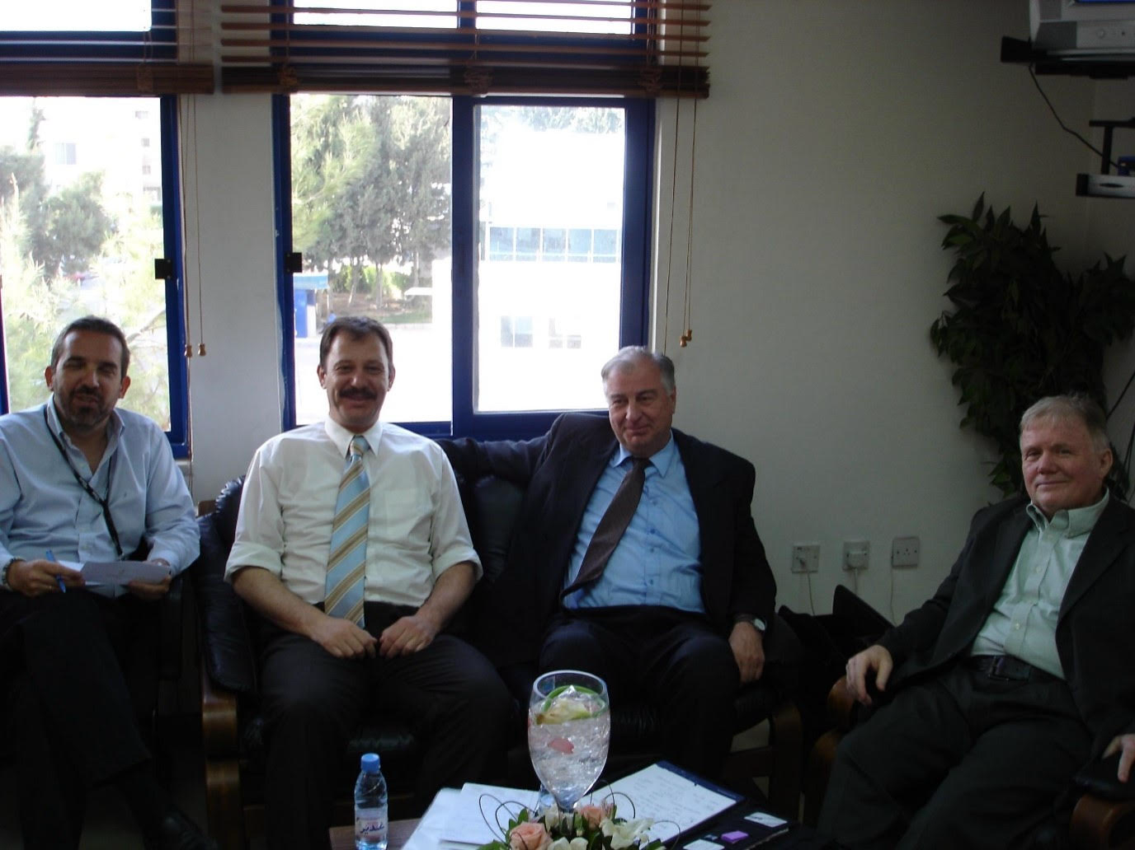

Slide 45
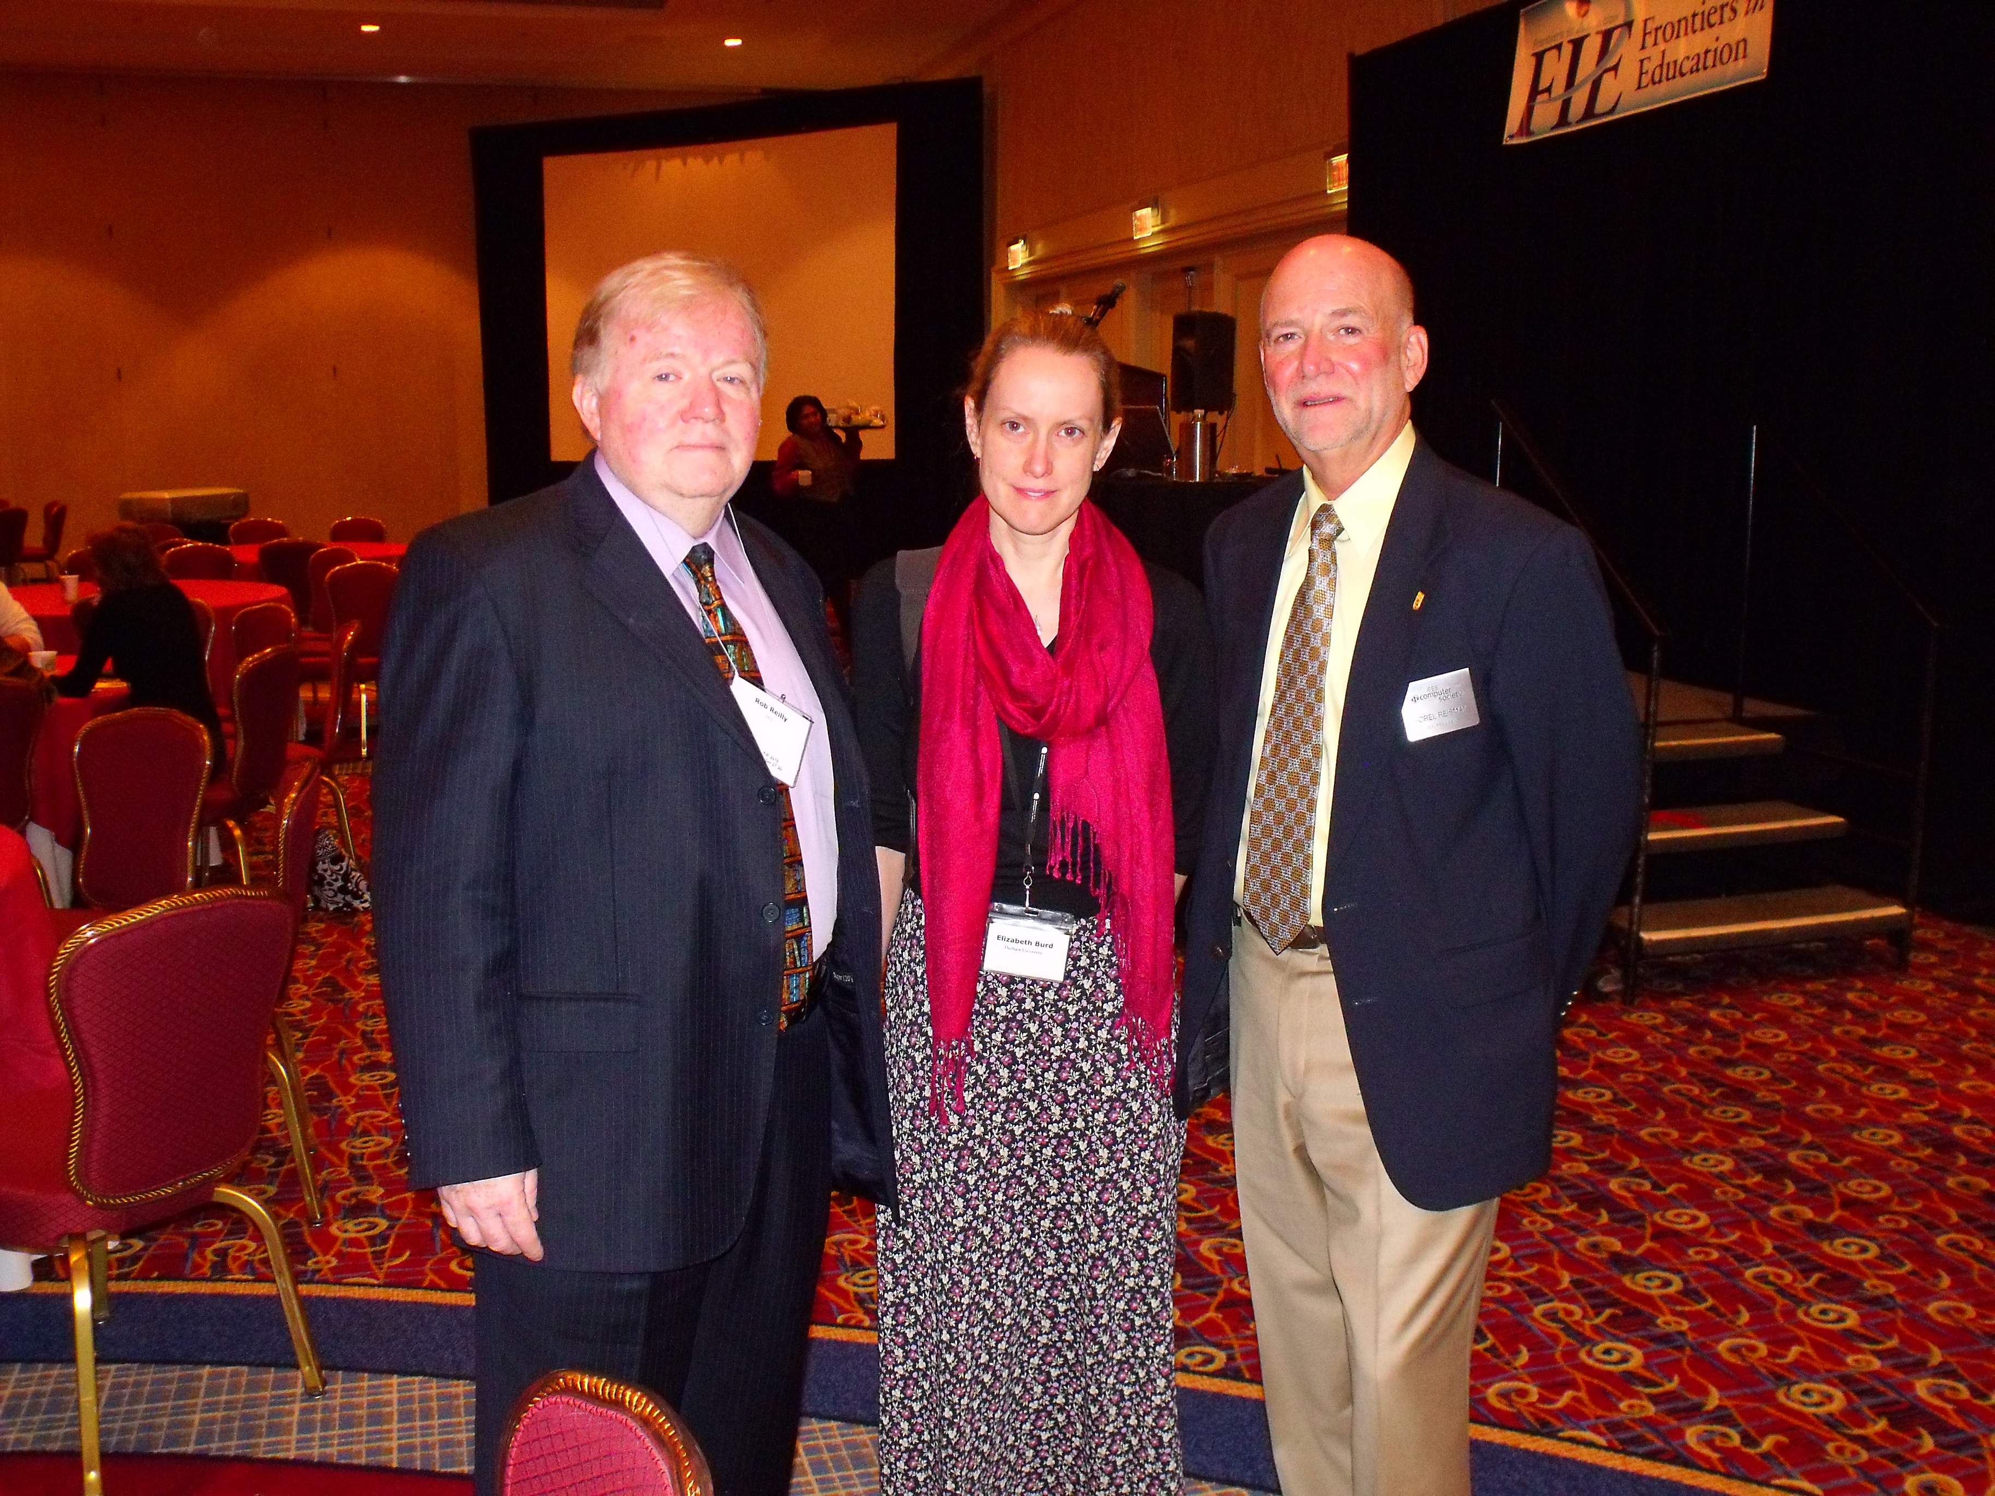

Slide 46
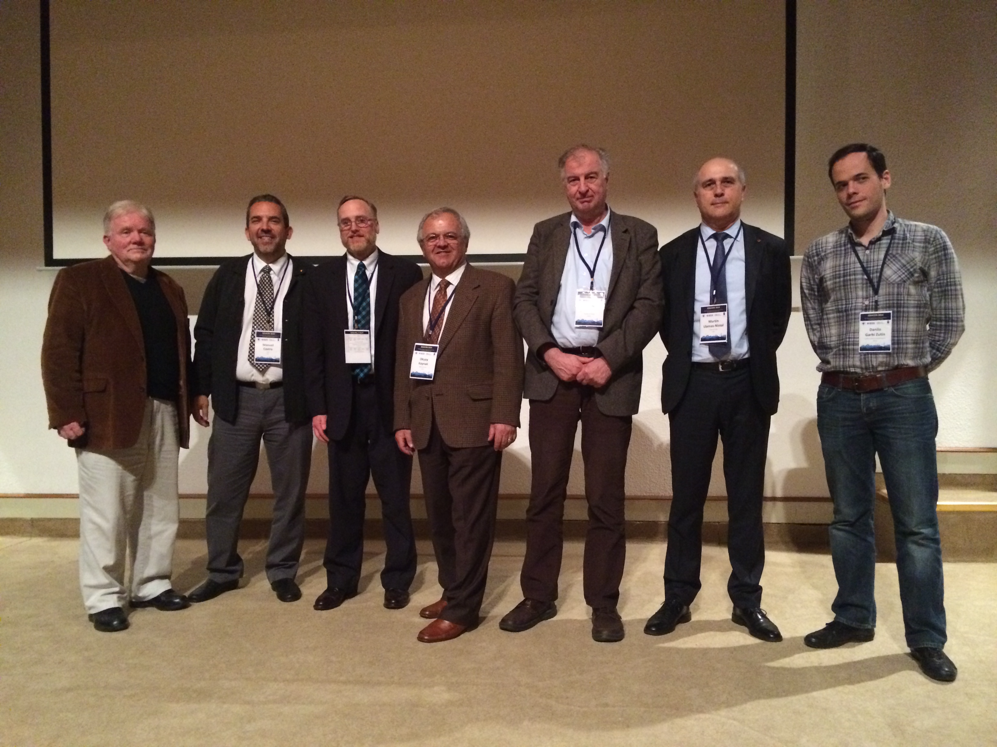

Slide 47
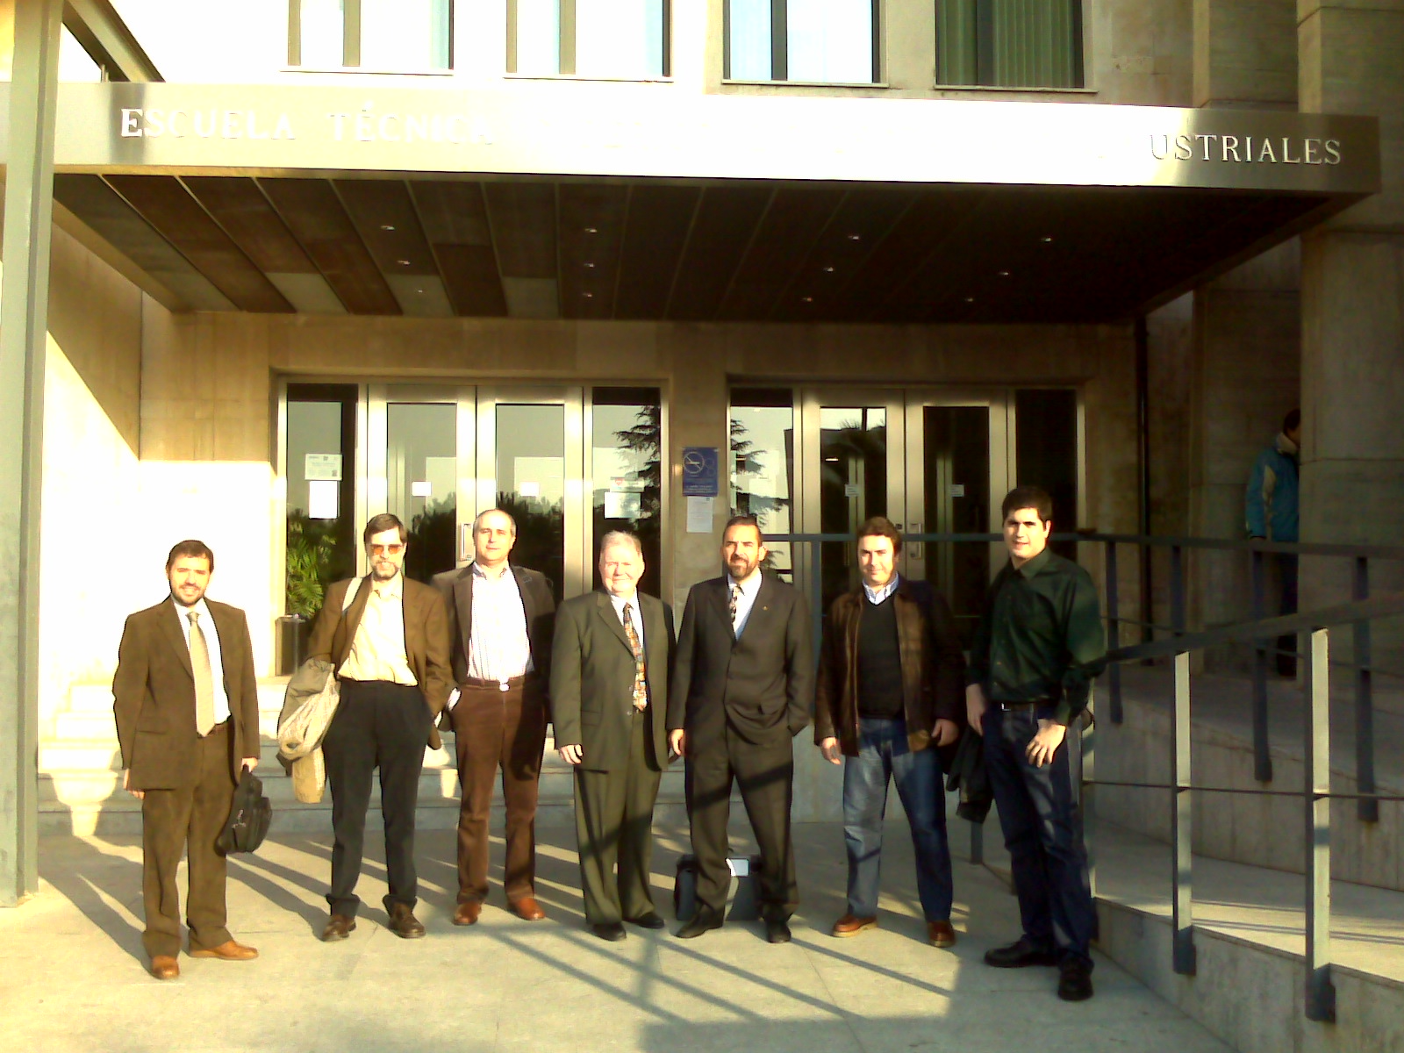

Slide 48
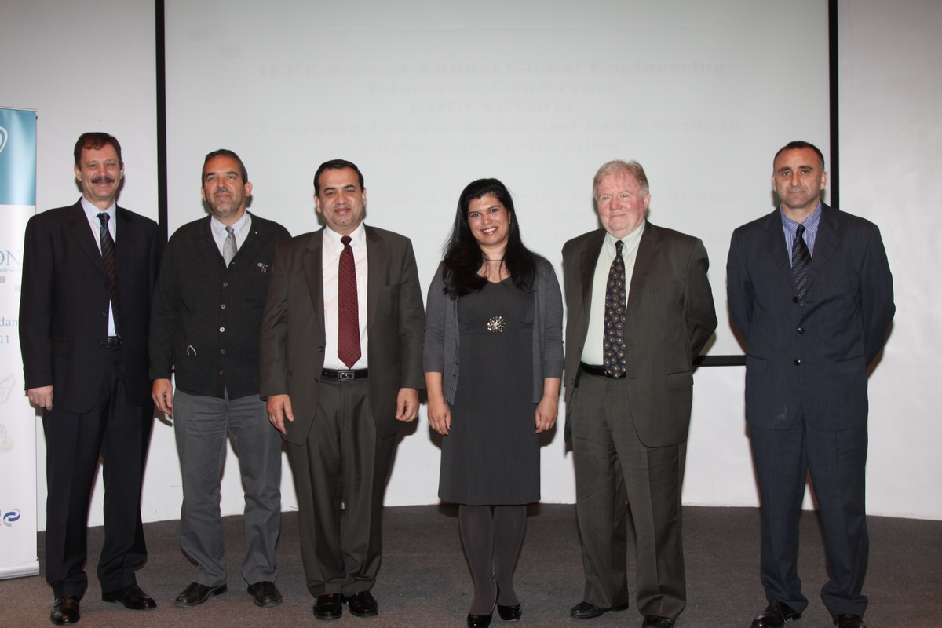

Slide 50
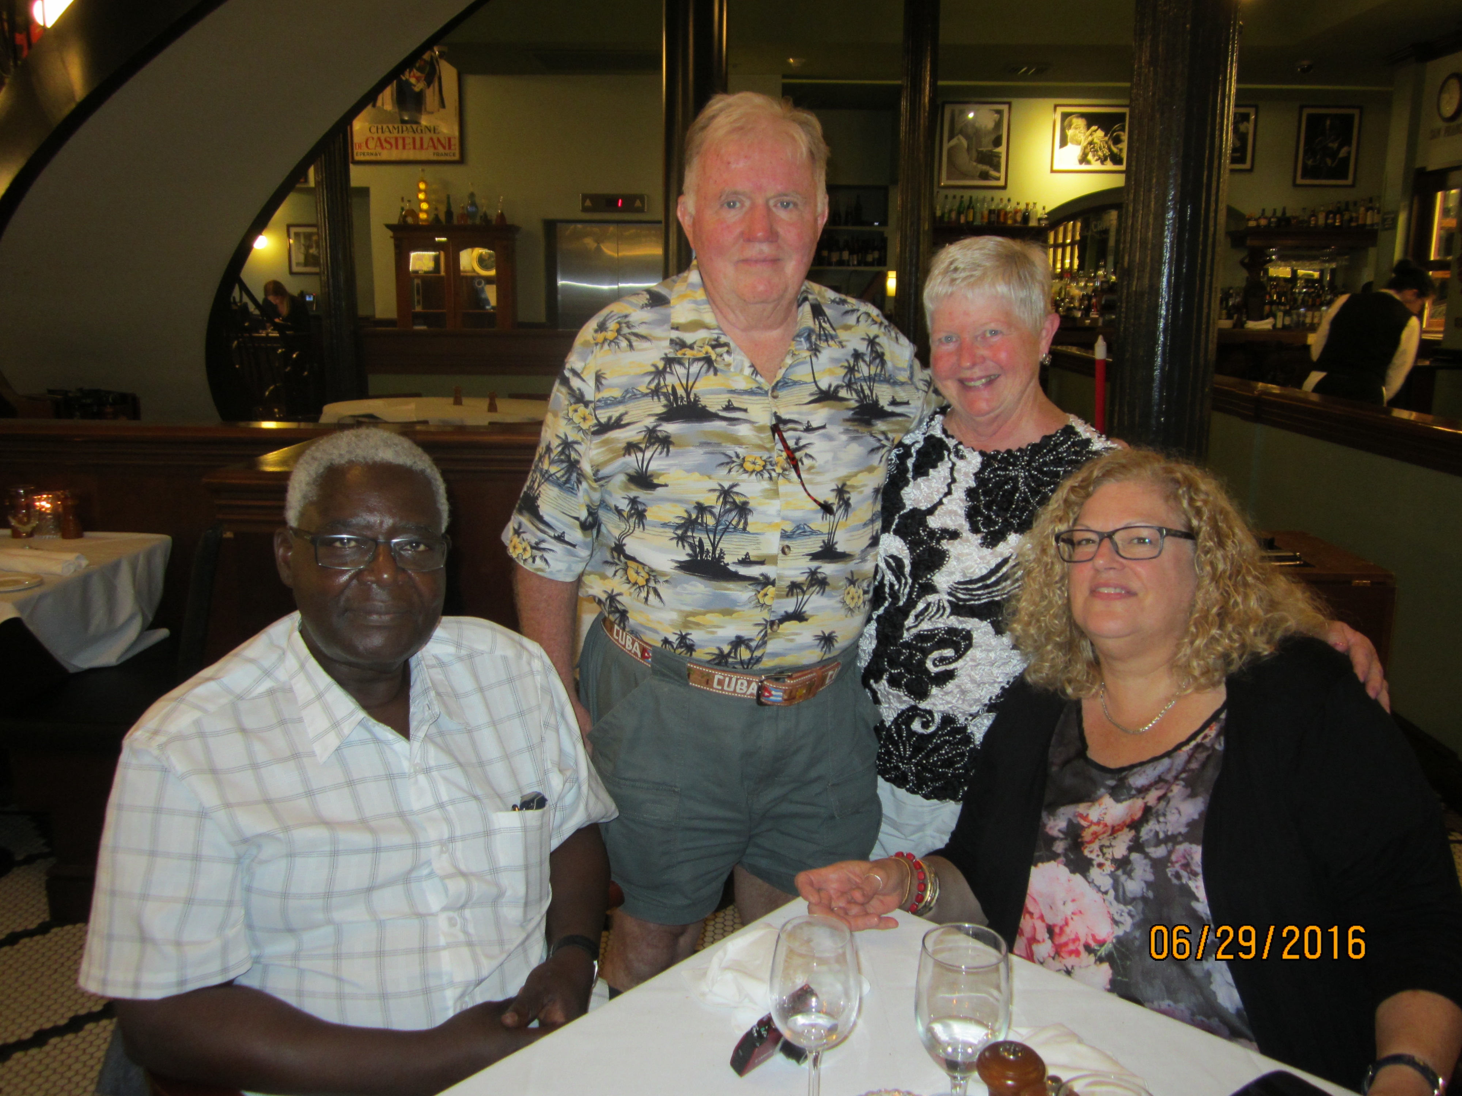

Slide 51
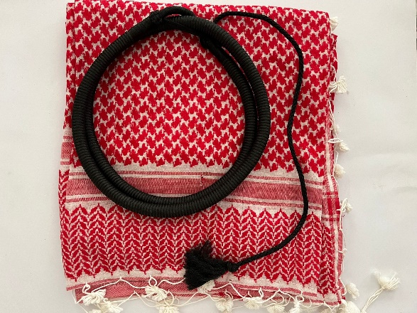

Slide 52
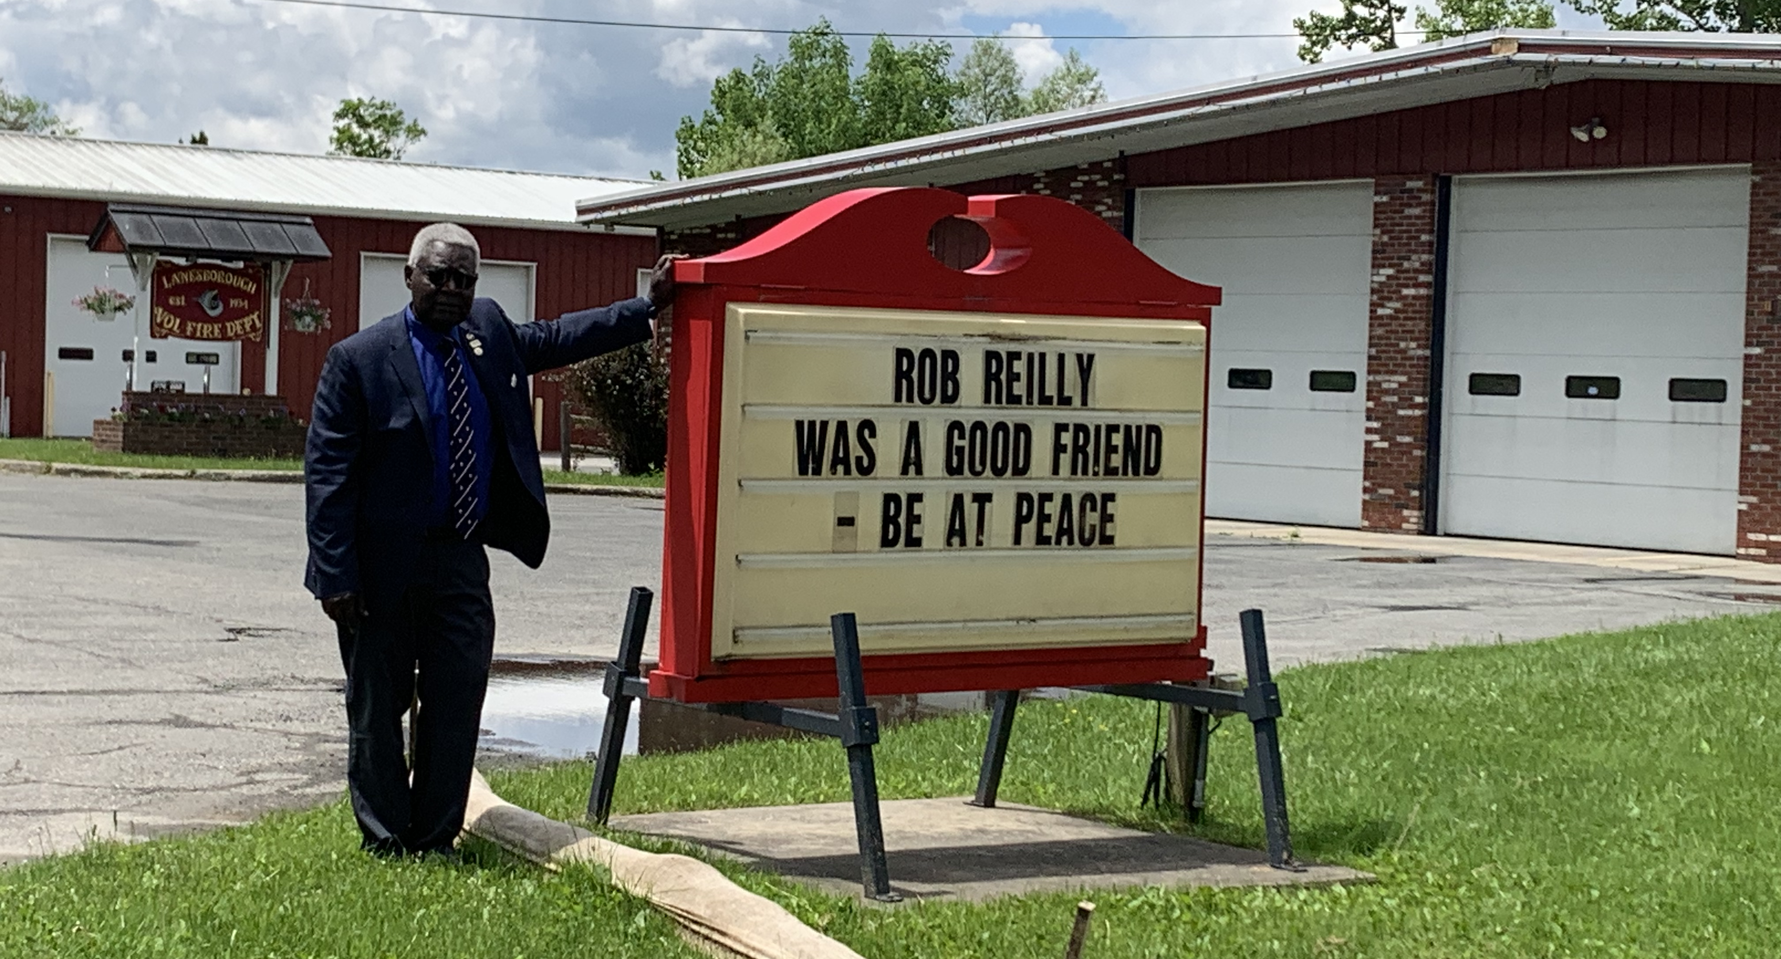
Thanks Rob from all your IEEE Education Society friends !

